Slide 1
Disruptive Cost - LO CEPS (Baseline: CR3005897 for Fiat 319/332) Stage I: CR3007570 (on going) Stage II: Feasibility and saving review
2016.05.16

Slide 2
Product Content Description – stage I (tangible initiatives)
MPP and EE:
CR3005897 baseline:
EA4
Baseline flash 1 Meg
2.9mOhm D2PAK
Current mode
Turns counter
Digital torque sensor soldered to CCA
Hall calibration table processing time
PHA: Selective solder changed to Wave Solder
PHA: FR4
TC: A1331 changed to A1337
New initiatives:
Motor with steel can
Smaller motor for 31:1
Schematic optimized
Eliminate components for "back EMF monitoring"
Column:
CR3005897 baseline:
Single piece rake bracket
14 teeth shaft
Capsule no coating
Common inner compression bracket
Share VSS laser welding equipment
New initiatives:
Press fit w/o EA strap
Column make in house with parts P2P
Fiat 319 design, 30 Nm & 56 Nm assist
Only EA 4, only brushless
Rake only column with energy absorb
AM & Worm:
CR3005897 baseline:
Fix worm
Solid coupling
Zoning, no eccentric
Mounting hole machining in house
Friction spec relief
No paining
New initiatives:
31:1 gear ratio
2 lead worm
24 OD worm bearing
Fast whirling + Fast grind worm process
Shaft Assembly & Sensor:
CR3005897 baseline:
Stamp stator lower rotor
No knurl on upper shaft to upper rotor interface
Remove knurling for gear interface
New initiatives:
Axial stack sensor upper rotor
Change spline to knurl on lower shaft interface to lower rotor
No degaussing process
2 stop teeth
No sticky grease
T-bar simultaneous press
Tangible Initiatives:
With DEV validation
With similar application
With supplier input
With benchmark competitor
With CAE evidence

Slide 3
Cost down initiatives– stage II
White items are followed by Disruptive PDT
Highlighted items are not followed in PDT.

Slide 4
Cost down initiatives– stage II
These items can classified in 5 groups:
AM (yellow)
Motor (blue)
PCB (brown)
EE (pink)
Grey Box (grey)
Need to identify a way to follow these effectively to
Clarify direction, priority
Guidance estimate saving for each product family
Resource/ownership
Timing plan
Communicate progress/result to disruptive task force

Slide 5
Back up slides of Stage I design details

Slide 6
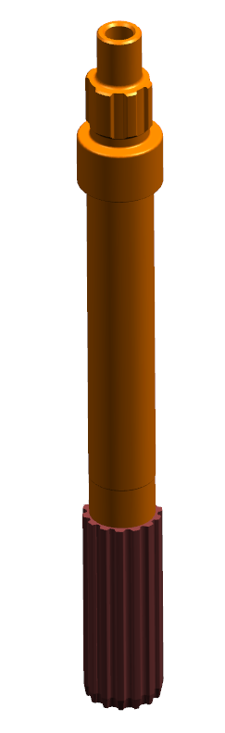
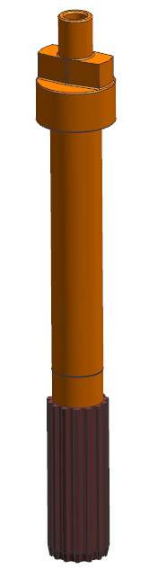


Shaft-Sensor Rotor Interface change and Two-Tooth Stop Teeth - Upper Assist Shaft
38219969
38222055
No knurling
22.76 mm
Knurling
27.5 mm
Stop teeth profile
Stop teeth profile

Slide 7
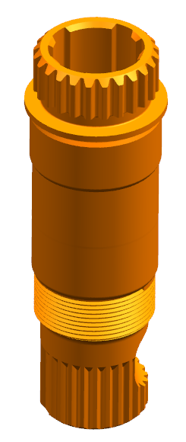
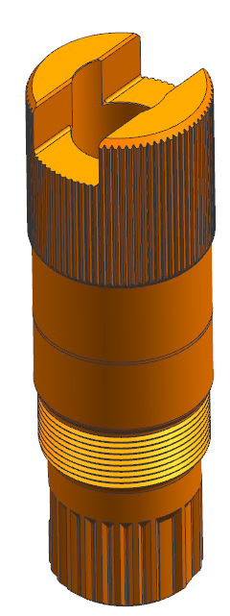


Shaft-Sensor Rotor Interface change and Two-Tooth Stop Teeth (cont.)
- Lower Assist Shaft
38004142
38222053
24 tooth spline
Class 3 straight knurl
28.5 mm
26 mm
26 mm
Stop teeth profile
Stop teeth profile

Slide 8
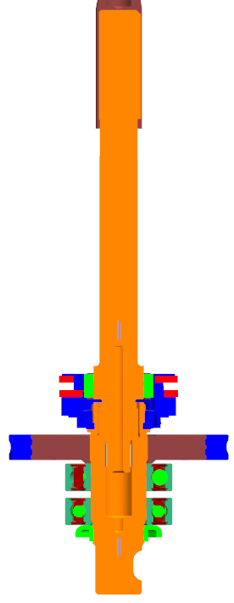
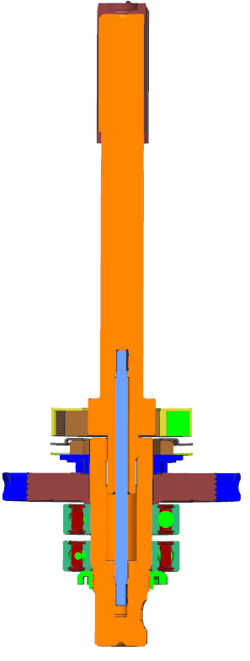

Shaft-Sensor Rotor Interface change and Two-Tooth Stop Teeth (cont.)
- Assist shaft assembly
Press lower rotor BEFORE t-bar press
Press lower rotor to shoulder
Press lower rotor to gear hub
26.2mm
25.8mm

Slide 9
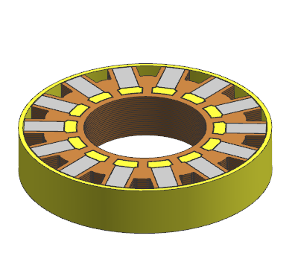
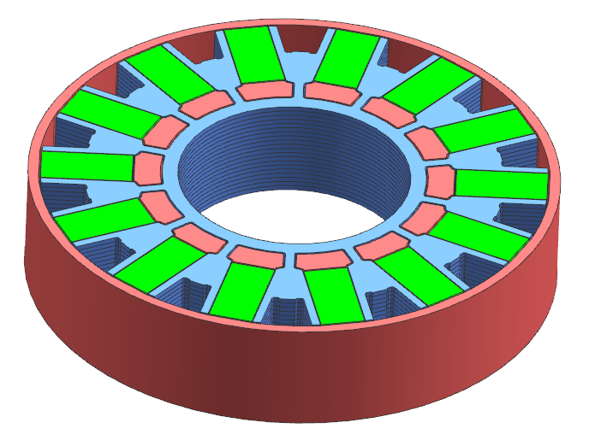
Axial Sensor application - Upper Rotor
SG207143
Baseline axial Upper rotor
38221638
Diameter enlarged with
same magnets
22.76 mm
27.5 mm
52 mm
56.74 mm

Slide 10
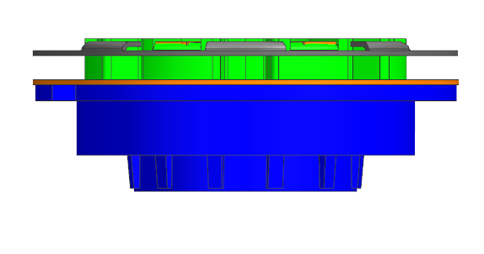
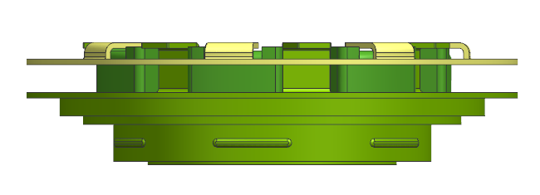
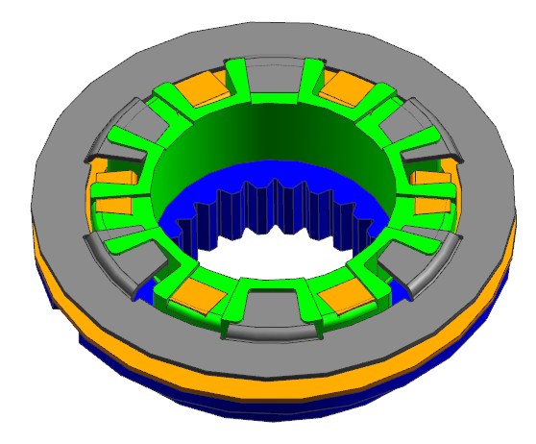
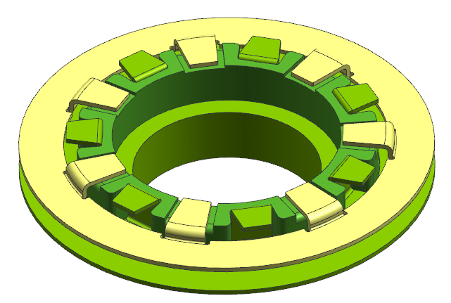
Axial Sensor application (cont.) - Lower Rotor
38219359
Baseline axial Lower rotor
Torque only design
38221399
Diameter enlarged for Two-tooth Stop Teeth design
55.3 mm OD
57.14 mm OD
19.8 mm
13.8 mm
24 tooth spline 23.185mm minor dia
No spline
26mm dia

Slide 11
Axial Sensor application (cont.) - Assist Housing machined

Slide 12
Axial Sensor application (cont.) - Sensor Cover

Slide 13
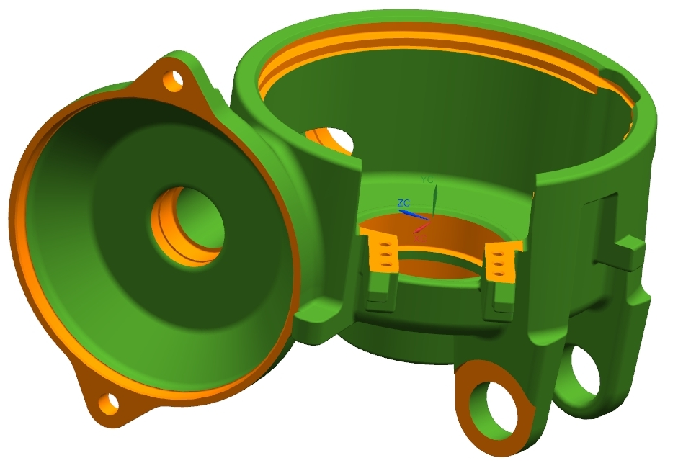
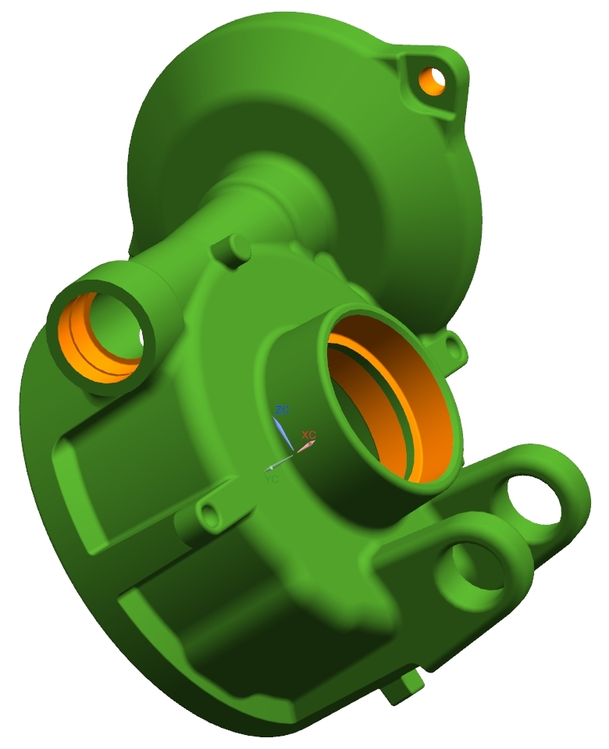
Reference CAD model of SG212037 (the latest design w/ 24mm bearing)

Slide 14
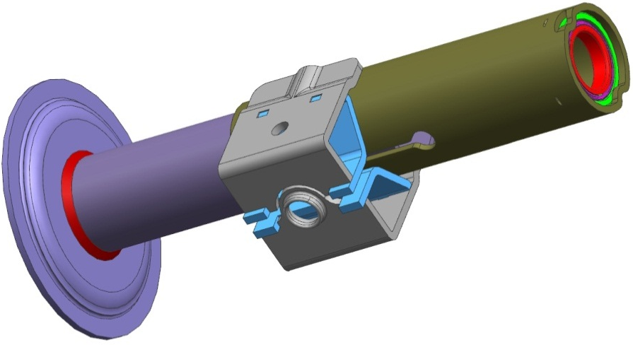
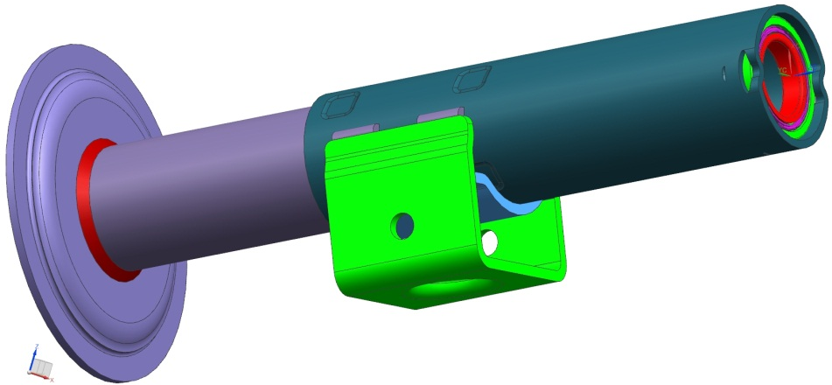
Fiat 319 split vs press-press upper jacket
Baseline – split upper jacket
New – press press upper jacket
Remove split from upper jacket
Add 8 pad protrusions to upper jacket
Change from two piece compression bracket to single piece
Change from laser weld to MIG weld for compression bracket to upper jacket weld
Change from slip fit to press fit between upper & lower jackets.

Slide 15
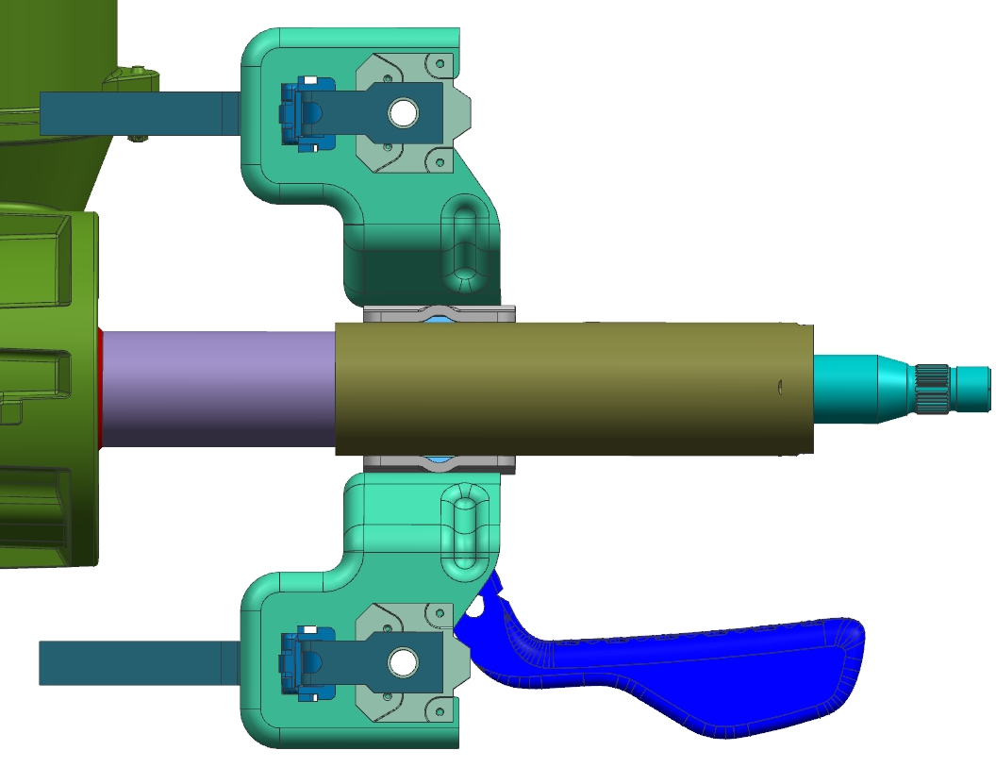
Fiat 319 remove E/A straps
Remove E/A straps & retainers
Remove holes for strap retainer from rake bracket

